Slide 1
Info 5100 : Application Engineering and Development
Lab 1 : Class and Object

Slide 2
Objective
Demonstrate how to create a java/swing application
How to define java classes
How to create and populate java objects
How to pass data between from the Jframe to JPanels

Slide 3
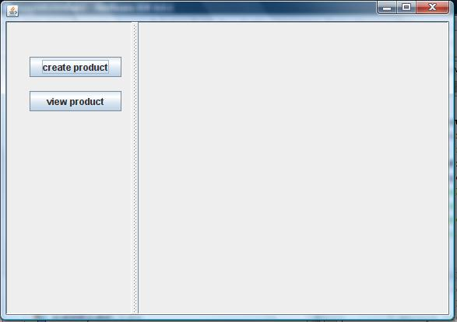
Output Application 1

Slide 4
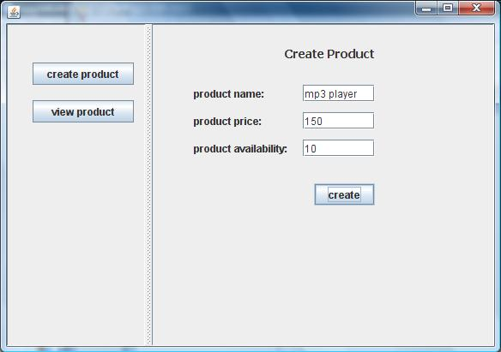
Output Step 1
1
2

Slide 5
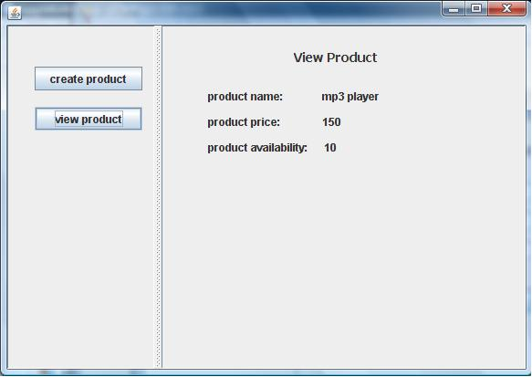
Output Step 2
1
2

Slide 6
How to create and move data in and out of objects?
Data
-Name
-Price
-Availability
Display
Product
Object

Slide 7
The approach:
class Product {
<attributes>
:
<methods>
}
Product Class
Use the java new operator to instantiate the class
new product()
Product
Object
Data
-Name
-Price
-Availability
Display

Slide 8
Java Reference variables
When we create things we need to keep track of them. If we don’t we would never be able to find it.
A reference variable has a name. We use the name to find the variable and then look inside to find information about where the object is
Memory space (a place holder) for keeping track of an object but it is not an object in itself
An object has a numeric address of where it can be found
We save the address inside the reference variable as a way to get hold of the object
p1
If object address: 0298289
0298289
Dell Laptop 2021

Slide 9
Java Reference variables
When we create things we need to keep track of them. If we don’t we would never be able to find it.
A reference variable has a name. We use the name to find the variable and then look inside to find information about where the object is
Memory space (a place holder) for keeping track of an object but it is not an object in itself
An object has a numeric address of where it can be found
We save the address inside the reference variable as a way to get hold of the object
p1
If object address: 0298289
0298289
Dell Laptop 2021

Slide 10
Java Reference variables
//example class definition Public class Product {
String name;
Public Product(){}
:
:
}
//Example main program:
public class Main {
public static void main(String[] args) {
// TODO code application logic here
Product p1 = new Product();
p1.setName("MacBook ...");
Product p2 = new Product();
p2.setName("Dell ...");
Product p3 = new Product();
p3.setName("Toshiba ...");
}
}
p1
MackBook 1101
Dell Laptop 2021
Toshiba Tecra 1100
p1 = new product()
p2
p2 = new product()
Product Class
p3 = new product()
p3

Slide 11
Instantiation: From classes to objects
p1
MackBook 1101
Dell Laptop 2021
Toshiba Tecra 1100
p1 = new Product()
p2
p1 = new product()
Product Class
p1 = new product()
p3

Slide 12
Swing application structure
JFrame
JButton
JPanel
JSplitPane

Slide 13
Jframe (MainJFrame)
Jpanel for create a product
Jpanel for displaying a product

Slide 14
Pass the product object
Jframe (MainJFrame)
Product Object
Create Product JPanel
Product Object
Input fields
NameTextField
PriceTextField
Customer

Slide 15
Jframe (MainJFrame)
Product Object
Create Product JPanel
Input fields
NameTextField
PriceTextField
Customer
name
price

Slide 16
Putting the display panels together
Jframe (MainJFrame)
Product Object
Display Product JPanel
Product Object
Output fields
NameTextField
PriceTextField

Slide 17
Putting the display panels together
Jframe (MainJFrame)
Product Object
Display Product JPanel
Output fields
NameTextField
PriceTextField
name
price

Slide 18
Procedure
Create a new project
Define Business Package
Create product class
Define UserInterface Package
Define JFrame
Define Jpanels (Create and View)
Button listeners

Slide 19
Create Product Class under the business package
Product
name
price
availability
description
Attribute
Method

Slide 20
Product Class
public class Product {
private String name;
private String price;
:
public String getName() // retrieve data
{ return name; }
:
public void setName(String n) // keep data
{ name = n; }
:
}

Slide 21
Define MainJFrame Class under the userinterface package
Create a global variable of product for this class
class MainJFrame {
public MainJFrame() {
initComponents();
}
}
Constructor
Method that creates visual components

Slide 22
Define MainJFrame Class under the userinterface package
Create a global variable of product for this class
class MainJFrame {
private Product product; // Global Variable
public MainJFrame() {
initComponents();
product = new Product(); // Instantiate the object (global variable)
}
}

Slide 23
Define CreaCreateProductJPanel class under the userinterface package
class CreateProductJPanel() {
CreateProductJPanel() {
initComponents();
}
<other stuff>
}
Constructor
Method that creates visual components

Slide 24
Define CreaCreateProductJPanel class under the userinterface package
class CreateProductJPanel() {
CreateProductJPanel(Product p) {
initComponents();
product = p;
nameTextField.setText(product.getName());
priceTextField.setText(product.getPrice());
}
<other stuff>
}
Constructor

Slide 25
Create Product
In the constructor of CreateProductJPanel class
public CreateProductJPanel(Product p) {
initComponents();
}

Slide 26
View Product
In the constructor of ViewProductJPanel class
public ViewProductJPanel(Product p) {
initComponents();
this.product = p;
nameTextField.setText(product.getName());
priceTextField.setText(product.getPrice());
}

Slide 27
Button Events
When Create or View buttons are clicked on the left side, the following actions should be performed respectively.
Create Button
CreateProductJPanel j = new CreateProductJPanel(product);
jSplitPane1.setRightComponent(j);
View Button
ViewProductJPanel v = new ViewProductJPanel(product);
jSplitPane1.setRightComponent(v);

Slide 28
Create Button
When “create button” is clicked, following actions should be performed in the action perform method of the button
p.setName(nameField.getText()); //
p.setPrice(priceField.getText());
p.setAvailability(availabilityField.getText());

Slide 29
View Button
When “create button” is clicked, following actions should be performed in the action perform method of the button
nameTextField.setText(p.getName());
priceTextField.setText(product.getPrice());

